Slide 1
Analysis of Glassdoor Reviews for S&P Global

Slide 2
Agenda
Executive Summary
Overview
Good Words about the Organization
3 Themes for Pros and Cons
What US and India Employees liked
Future Work Opportunities
Appendix

Slide 3
Executive Summary
Objectives
Identify hidden issues that might impacting employee experience.
Key Observations
Overall Employees were satisfied with 3.2 Average overall satisfaction (out of 5).
Hot topics are Work Life Balance, Management, Work environment, People, Benefits, Brands, Leadership, Salary, Opportunities etc.
50% of the reviews are from US and India employees.

Slide 4
Overview
571
129
~ 5
41%
53%
47%
47%
81%
Reviews by former &
current employees
# Months
Average monthly reviews
Is the % of the employee from US
Of the reviews from current employees
Of the reviews from former employees
Avg. Recommender
Score
Approved Current CEO (on an Average)
Median = 2.8
Median = 3.5
MC 15-Apr-19:
Is this that they started increasing at 2012? Or is this maybe about how they are increasing consistently year over year? Also, not sure we’re consistently increasing. I’d actually say that we’re hovering around the same recommendation rate 3.3-3.5. So I’d re-think the takeaway here.
DS 17th April:
Here I was thinking to provide insights like – Even after review comments count is increasing, overall satisfaction rating is not increasing. Except a sharp increase from 2012 to 2013
Overall, Employees were more vocal from 2012 onwards, Review Count increasing, Median Avg. Overall Satisfaction ratio increased from 2.8 to 3.3
MC 15-Apr-19:
Not sure this is the right title here. What’s the takeaway?? I’m not sure the title aligns with the graph
DS 17th April:
I would like to convey a message that When employee joined the company, he or she is very like the culture and recommending the company to others, however we can see sharp decline during 1 to 3 Years in the company. Can we find out that what’s there issue ? May be we have maximum attrition is happening at that level and can tie back both of these together. When I draw the word cloud for these employees, major issue found out as :
Salary
Growth
People
Work etc.
2008
2009
2010
2011
2012
2013
2014
2015
2016
2017
2018
2019
Average Overall Satisfaction
Number of reviews
50% Reviews from US and India; Avg. Overall Satisfaction rate was good except few Countries
Overall Employees are recommending Organization to others (with a good satisfaction level, more than 60%) , except the employees who spend 1 to 3 Yrs. in organization
Title this graph
3.2
59
64
62
US
India
UK
Philippines
Singapore
Pakistan
Other
Average overall satisfaction rating
Number of reviews
< 1 Yr
1 to 3 Yrs
3-5 Yrs
5-8 Yrs
8-10 Yrs
> 10 Yrs
Average overall satisfaction rating
Number of reviews

Slide 5
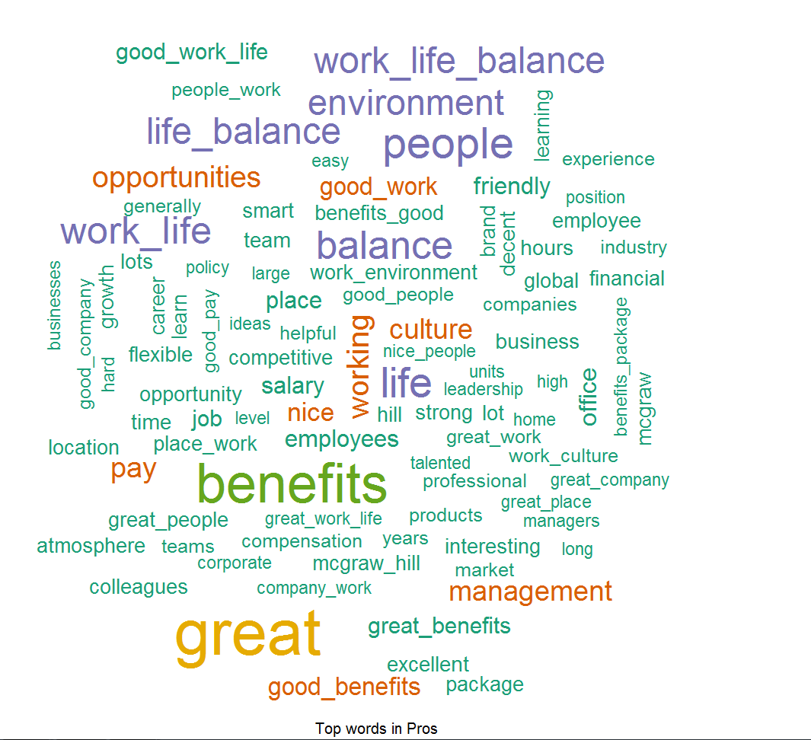
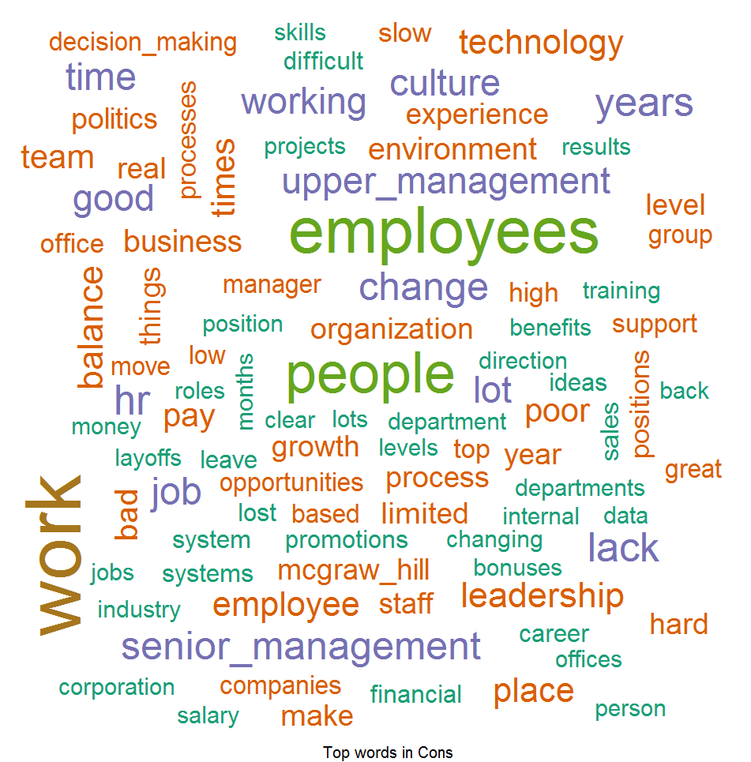
Good Words about the Company
MC 15-Apr-19:
Is this just about employees? Or also former employees? Candidates?
DS 17th April:
This is for both Current and Former employees only. I created 2 more slides similar to this one (in appendix) for Current and Former employees.
Pros: Things which Employees liked –
According to Employees feedback, we found out that people love our Benefits, Work Life Balance, Friendly Environment, Culture and Opportunities provided by S&P and they are spreading good words on this front.
Cons: Word List which Employees don’t like –
Feedback provided by the Employees they found out to difficulty to cope up with Working Environment, HR Processes, Decision Making, Growth, Promotions and Layoffs and this can be improved.

Slide 6
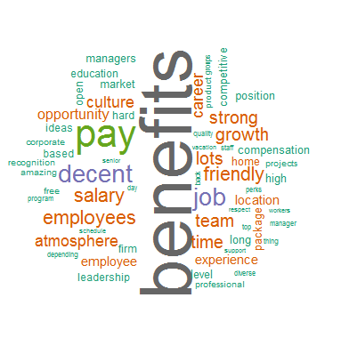
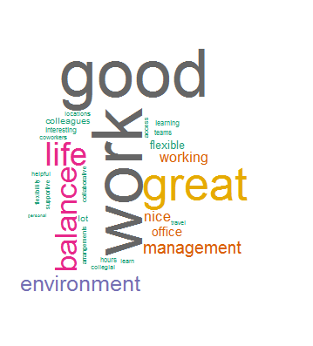
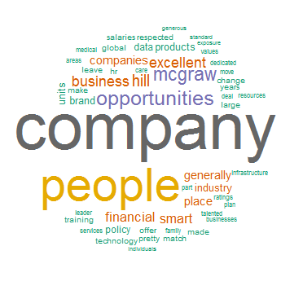
Top 3 Themes – For Pros
MC 15-Apr-19:
I think we have to try to change the language so it’s more digestible for non-data science folks. If I understand it correctly, we’re saying that positive comments can be groups into 3 topics:
Theme 1: work life balance, flexible work, interesting work
Theme 2: benefits, salary, culture, growth
Theme 3: opportunity, people, company, brand
Let’s title each of these work clouds as the theme
DS 17th April:
I named these Themes according to Word occurrences and rephrased of the sentence.
We identified three themes, based on word occurrence in collection of positive comments and closeness from other words (Statistically), Which employees liked
Theme 1: Respect to Personal Life and Work
(Work Life balance, Flexible, Interesting and Good work)
Theme 2: Financial Oriented (Benefits, Salary, Pay, Growth)
Theme 3: Equity Brand
( People, Company, Brand, Opportunity)

Slide 7
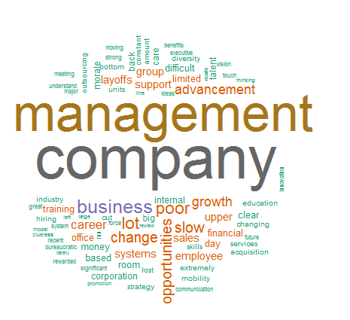
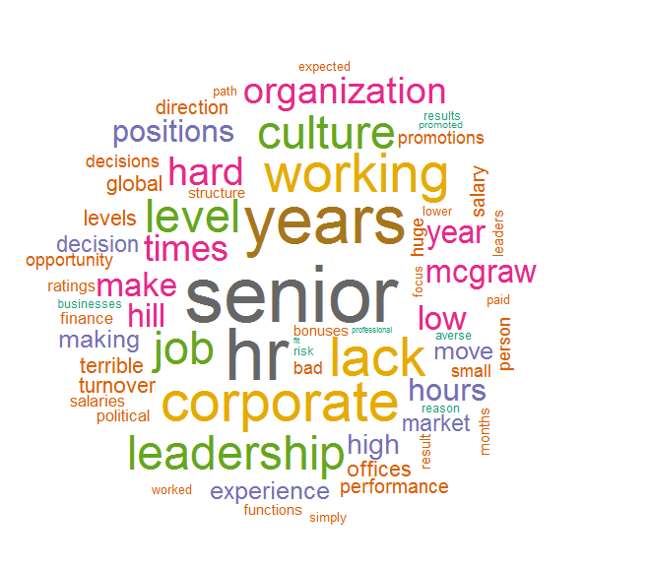
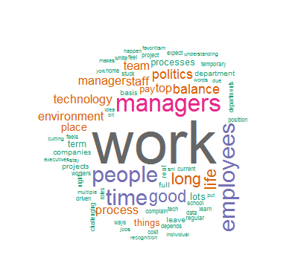
Top 3 Themes – For Cons
MC 15-Apr-19:
Try to follow the previous slide format
So, let me understand, on this page we’re seeing themes around growth, opportunity. We saw that on the previous slide as well around pros. So let’s make sure we’re super clear about what the difference is.
DS 17th April:
I named these Themes according to Word occurrences and rephrased of the sentence is also done.
We identified three themes based on word occurrence in collection of negative comments and closeness from other words (Statistically), Which employees didn’t liked
Theme 1: Job Security
(Management, Company, Layoffs, Growth, Opportunities)
Theme 2: Growth Opportunities
(HR, Culture, Promotions)
Theme 3: Work and Pay Issues
(Work, Managers, Politics, Pay, Process)

Slide 8
What US and India Employees liked
What US Employees liked –
Work Life Balance
Good Work
Good Culture
Great Benefits
Good Infrastructure
What US Employees didn’t liked –
Not enough Opportunities
Lots of Politics
Promotions
Leadership
What India Employees liked –
Work Life Balance
Growth
Good Pay
Policy
Work Culture
What India Employees didn’t liked –
Not Enough Opportunities
Promotions
No Learning Opportunity
Very Less / No Training
Lack of Challenging work

Slide 9
Future Work Opportunities
MC 15-Apr-19:
Let’s add a slide about next steps or thoughts/ideas on how to go deeper here:
Apply this to certain topics – are people talking about recruiting, orientation, onboarding, promotions, movement, anything?
Analysis of Exit surveys ( VIBE data ) and check “What Employees are talking”. Based on outcome of this analysis, we can measure similarities between both feedbacks.
Analysis of interview / recruitment experience.
EVP analysis and include different Social media channels like – S&P Global Facebook Page, Twitter Feeds etc.
Similar analysis can be performed on the few topics like – onboarding, Movement, orientation, First 30 days experience etc.

Slide 10
Appendix

Slide 11
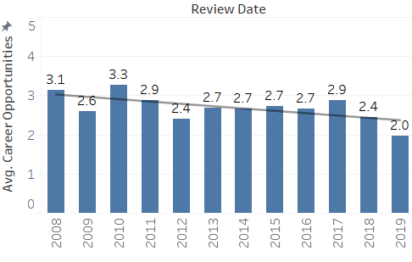
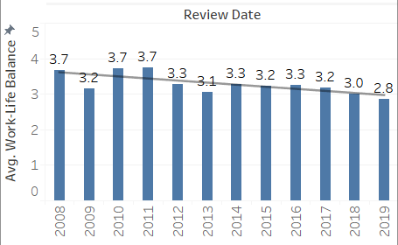
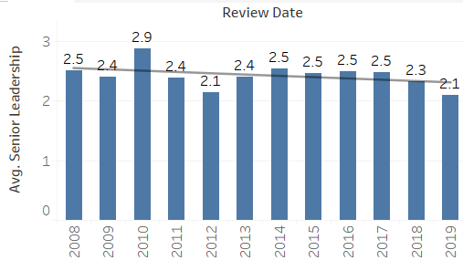
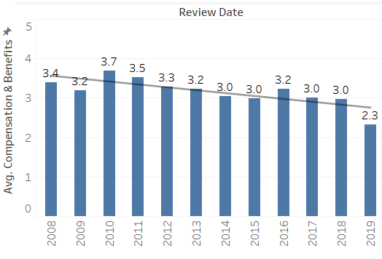
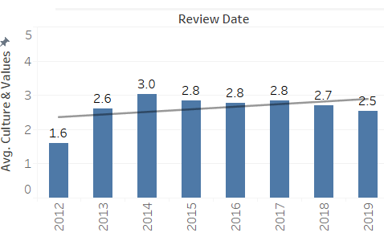
Overview – For 5 Subsections
Avg. Career Opportunity over the Years
Avg. Senior Leadership over the Years
Avg. Work Life balance over the Years
Avg. Comp & Benefits over the Years
Avg. Culture & Value over the Years

Slide 12
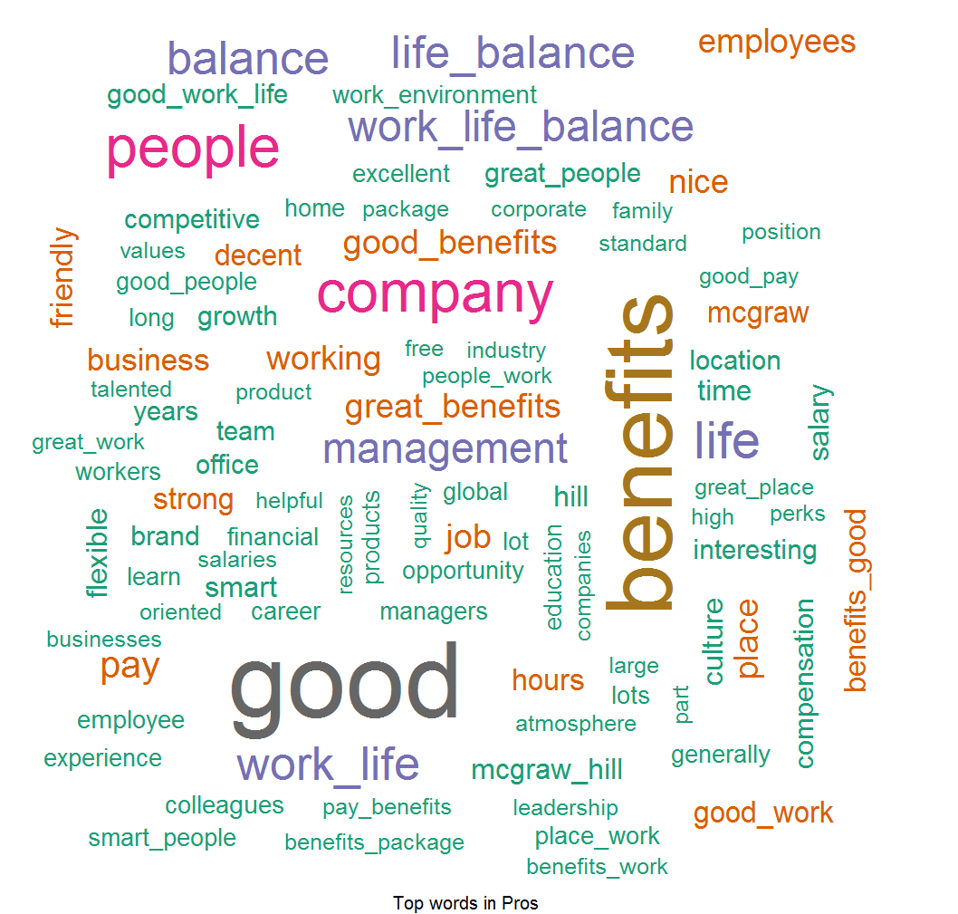
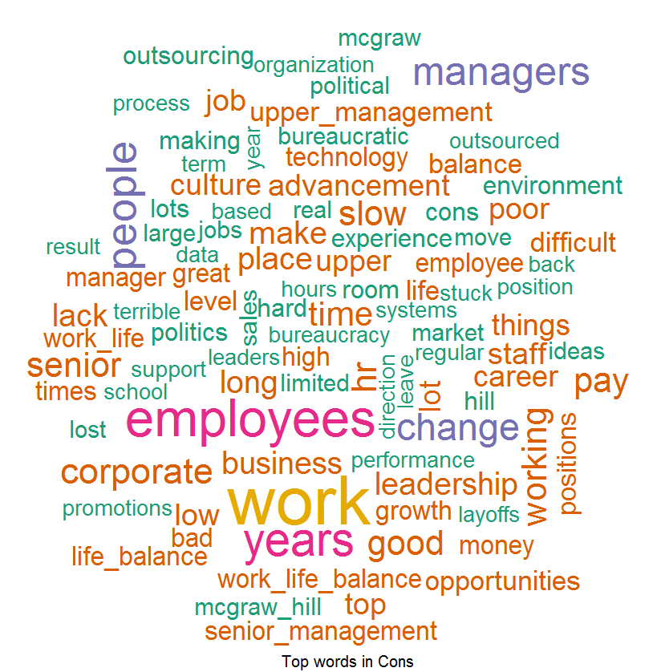
Word Cloud For US
MC 15-Apr-19:
I love this and next page! How can we show the comparison a little clearer?
Maybe one summary slide in the main deck. Show for the US and India the good words list and how those are prioritized and then the same for the things people don’t like.
DS 17th April:
Created a summary slides before this slide.
Word Cloud for Pros
Word Cloud for Cons
Good Words List –
Work Life Balance
Good Work
Good Culture
Great Benefits
Good Infrastructure
Word List which people don’t like –
Not enough Opportunities
Lots of Politics
Promotions
Leadership

Slide 13
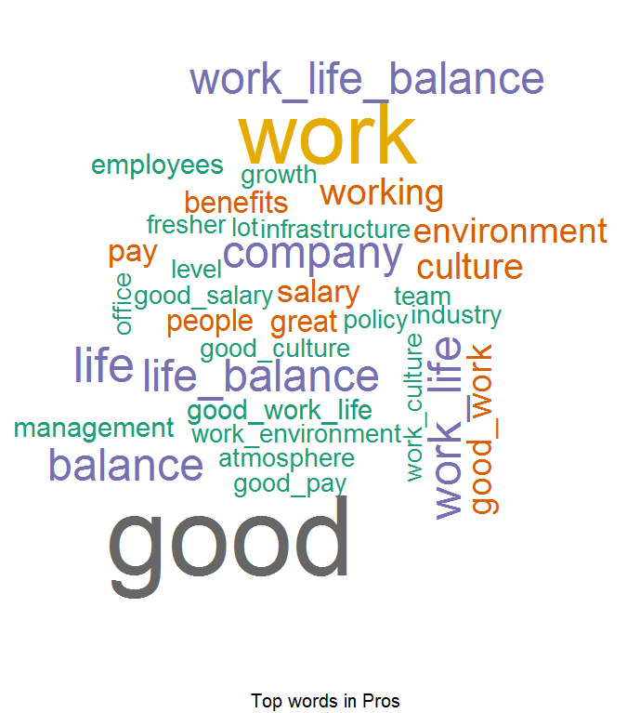
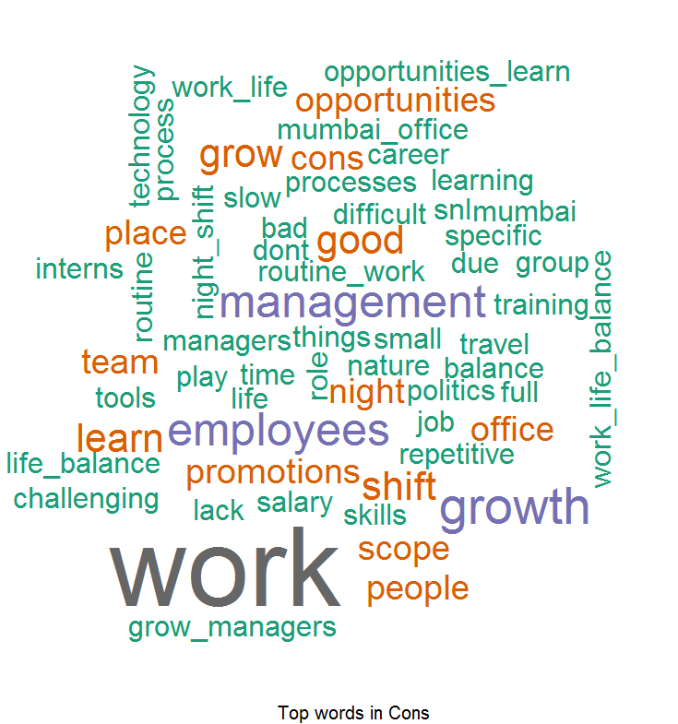
Word Cloud For India
Word Cloud for Pros
Word Cloud for Cons
Good Words List –
Work Life Balance
Growth
Good Pay
Policy
Work Culture
Word List which people don’t like –
Opportunities
Promotions
No Learning Opportunity
Very Less / No Training
Lack of Challenging work

Slide 14
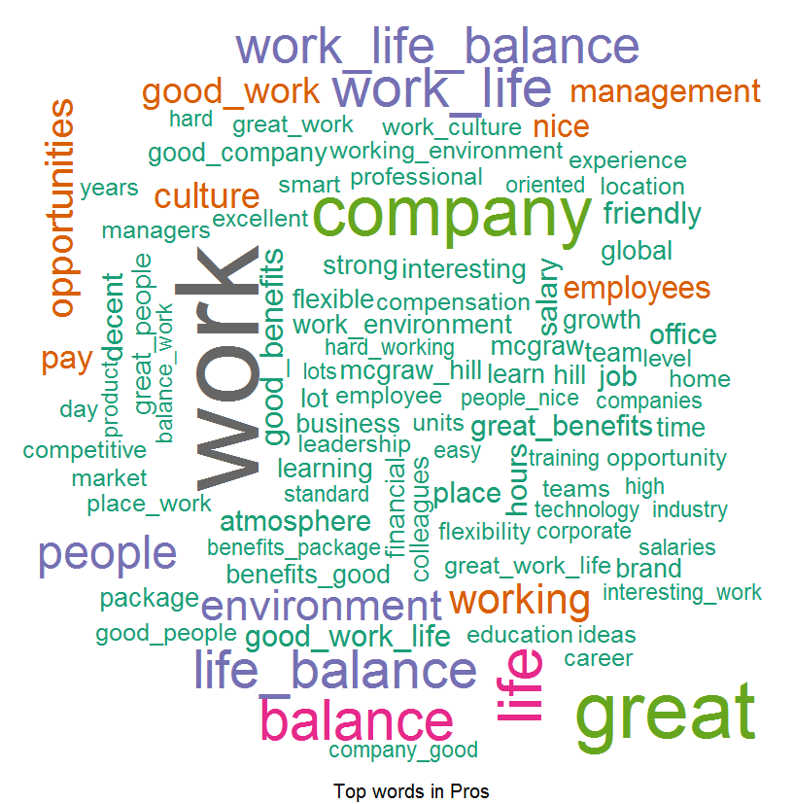
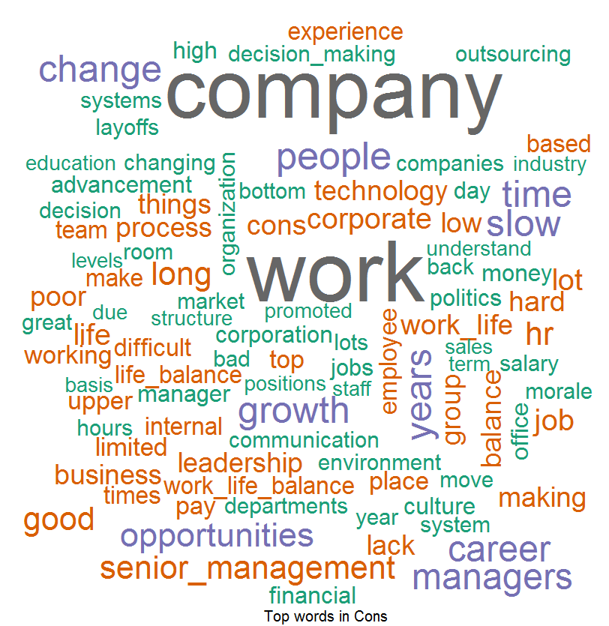
Word Cloud For Current Employees
Word Cloud for Pros
Word Cloud for Cons
Good Words List –
Work Life Balance
Good Work
Environment
People
Word List which people don’t like –
Work
Growth
Opportunities
Decision Making

Slide 15
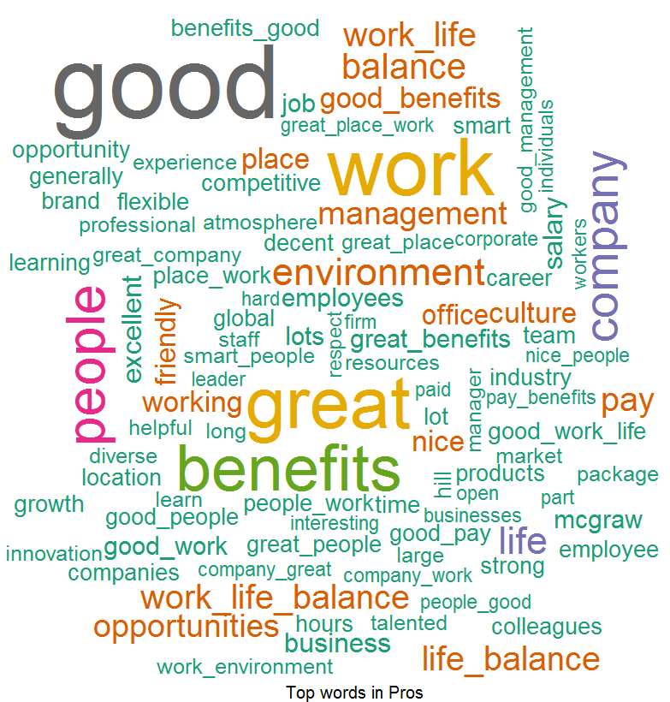
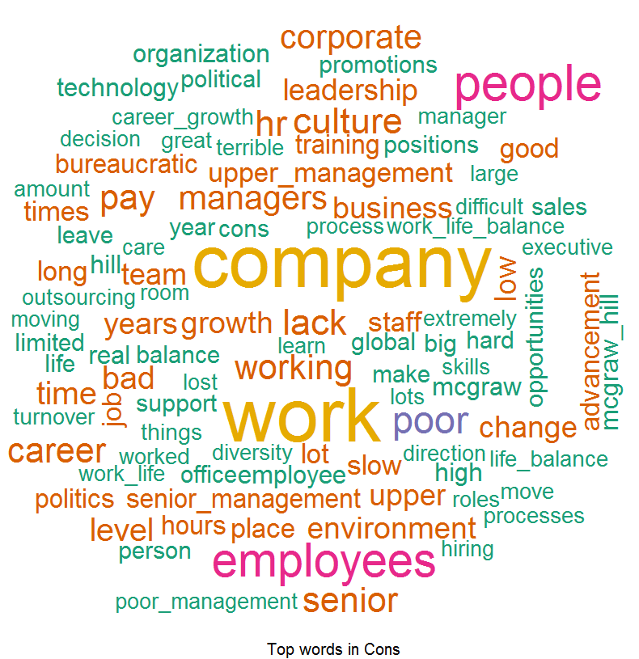
Word Cloud For Former Employees
Word Cloud for Pros
Word Cloud for Cons
Good Words List –
Work Life Balance
Good Benefits
Environment
People
Word List which people don’t like –
Growth
Culture
Politics
Bureaucratic Manager
Career Advancement

